Slide 1
Micropython & CBUS on the Pico
Using Micropython on the Raspberry Pi Pico to interface with MERG CBUS
Duncan Greenwood, January 2023

Slide 2
Topics (1)
Introduction and background
Arduino CBUS libraries
Python and MicroPython basics
Multi-tasking
MicroPython CBUS library basics
Some building blocks

Slide 3
Topics (2)
Layout objects – turnouts, signals, routes, NX, clocks
Driving trains with DCC
Towards layout automation
Hardware – CBUS shields and interfacing the Pico
Some useful resources

Slide 4
Introduction & background
Teenage electronics hobbyist & modeller
Home computing
Professional career
Philosophy and objectives

Slide 5

Arduino CBUS libraries
History
Recent updates

Slide 6


Python & MicroPython basics
What is Python ?
What is MicroPython ?
What is it good for ?
Limitations
Should I prefer it over C/C++ ?
Learning Python
Libraries, IDEs ?

Slide 7
Multitasking
Definitions
Opportunities
Limitations
What’s possible

Slide 8
Micropython CBUS Library
What is it ?
What can I do with it ?
How do I use it ?
How do I create a CBUS module ?
A ‘Getting started’ guide is in progress

Slide 9
Some building blocks
Locks, Events, Queues
Publish/Subscribe (aka pubsub)
Sensors
CBUS history
Enables asynchronous & event-driven programming
Usefulness will (I hope) become clear later !

Slide 10
Layout objects
Turnouts and signals (and groups thereof)
Routes
NX (eNtry/eXit)
Clocks and timekeeping

Slide 11
Driving trains with DCC
Command stations & locos
Block and spot detection
Uncouplers
Turntables

Slide 12
Towards layout automation
What do I mean by ‘automation’ ?
Sequencing & waypoints
Multiple concurrent train movements
Limitations & dependencies
Why ?
A CBUS module that can run arbitrary user programs

Slide 13

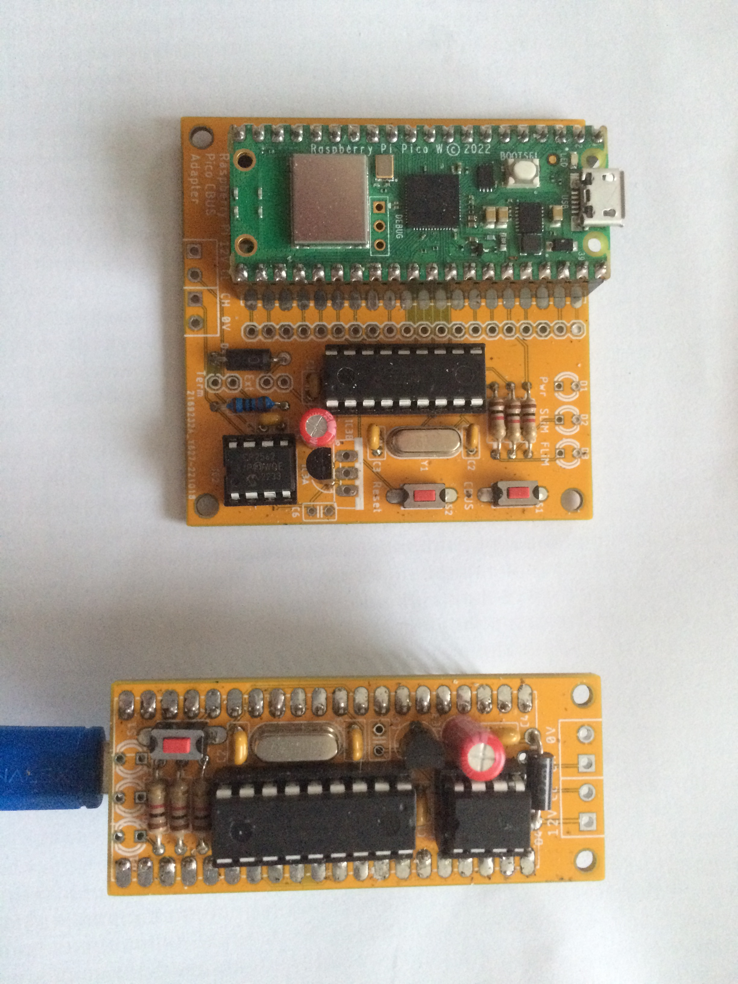
Hardware interfacing with the Pico
CBUS CAN shields
Other LCBs ?
Other devices
Servos, displays, other MERG modules, etc.
SPI, I2C, UART, GPIO, ADC, PWM
Level-shifting

Slide 14
Some useful resources
My GitHub (code, boards) - https://github.com/obdevel/CBUS-MicroPython-RP-Pico
MicroPython home - https://github.com/micropython/micropython
Official docs - https://docs.micropython.org/en/latest/
MERG wiki page - https://merg.org.uk/merg_wiki/doku.php?id=projects:micropython_for_cbus
Awesome MicroPython (lists of libraries, etc.) - https://awesome-micropython.com
micropython-lib (more libraries) - https://github.com/micropython/micropython-lib
Raspberry Pi Pico discussions - https://forums.raspberrypi.com/viewforum.php?f=143
Async/await resources & tutorial - https://github.com/peterhinch/micropython-async

